Slide 1

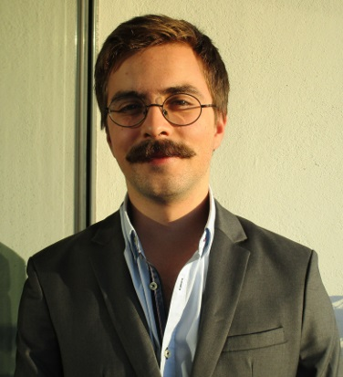













EDUCATION
Bologna Degree in Information Systems and Computer Engineering 2012 – July 2017.
Bachelor of Science
Instituto Superior Técnico Average grade of 13/20.
A-levels
2010 – July 2012
City College Plymouth, UK
Average Grade: B
Subjects: Maths, Physics and Film Studies.
WORK EXPERIENCE
Summer Internee – JULY 2016 – AUGUST 2016
Bridge Robotics – Lisbon
bridgerobotics.com
Worked in frontend development, object-oriented programming in python and javascript, websockets and messaging platforms like RabbitMQ and crossbar.io to test and extend the Bridge Robotics framework.
SKILL / INTERESTS
Frontend Software Developer– September 2016 – September 2017
opprDev– Lisbon
oppr.io
Oppr is a student created organization whose goal is to find paid work and to share the workload with other like minded students. With opprDev I further developed my frontend programming skills.
Consultant on Computer Engineering – December 2017 – Present
AKKA Technologies– Toulouse & Lyon, France
akka-technologies.com
For the past two years I’ve had the pleasure to work as a consultant with AKKA Technologies. I’ve worked under a variety of projects for multiple clients, and have worked with a veritable buffet of different technologies.
By all means consult my personal website or get in contact to discuss the various projets and clients I’ve had the pleasure to work with.
JOAQUIM ESTEVES
Date of Birth: 01/09/1993
Nationality: Portuguese
14Bis, Chez Nestor, Rue Nicolaï, Lyon 69007
France
joaquimbve@hotmail.com
+351 91 399 30 37
Personal Website:
joaquimesteves.github.io
HARD SKILLS
C ★
C++ ★
JAVA ★
SQL ★ ★ ★
PHP ★ ★ ★ ★
Python ★ ★ ★ ★ ★
HTML – CSS – SCSS ★ ★ ★ ★
JavaScript, Typescript, React & JQuery ★ ★ ★ ★
Languages
Portuguese– Native
English – Full Professional Experience
Spanish – Fluent
French – Basic Use
Driving License B1, B

